Slide 1





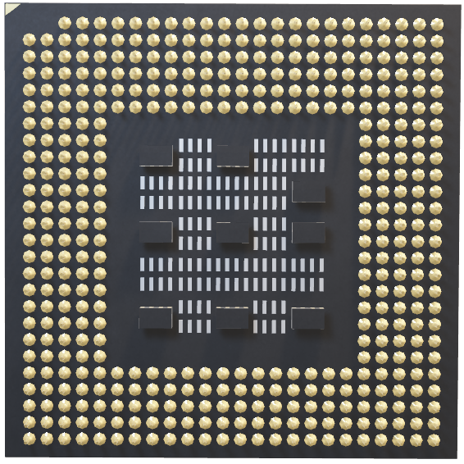
Designing an RFID-Based Solution for Accurate Attendance Tracking and Cashless Transactions in Educational Institutions
Hossam Mohamed 213885
Supervised By : Dr. Moataz Samy

Slide 2
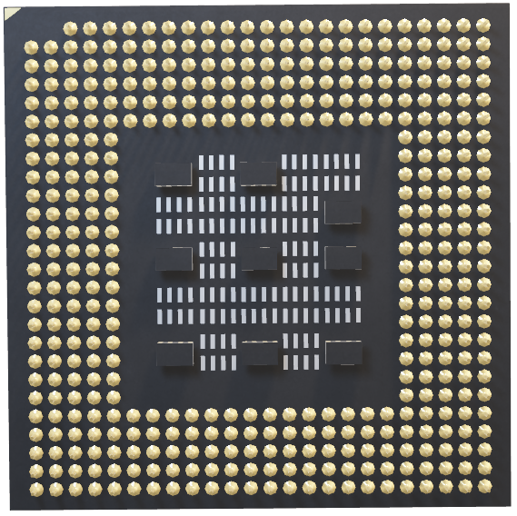

INTRODUCTION
Educational institutions face challenges with traditional systems for tracking attendance and handling cash transactions
Our proposal introduces an RFID-based system that automates attendance tracking and facilitates secure, cashless transactions on campus.

Slide 3
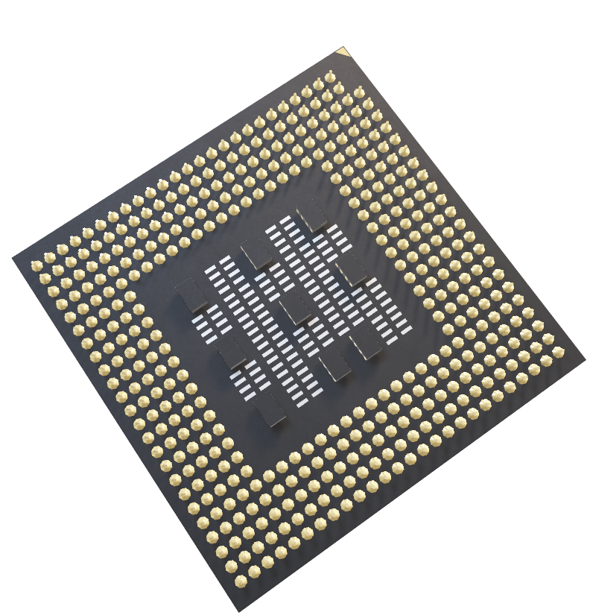
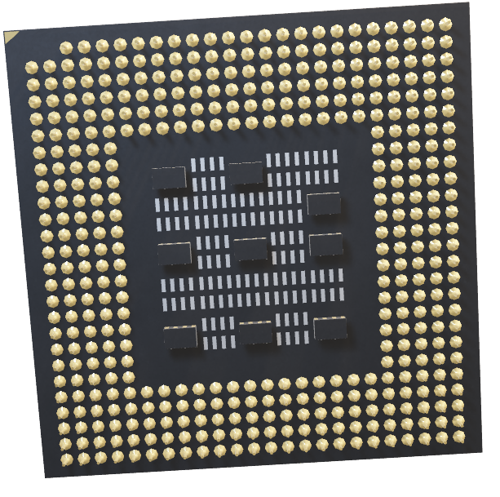
Background

Slide 4

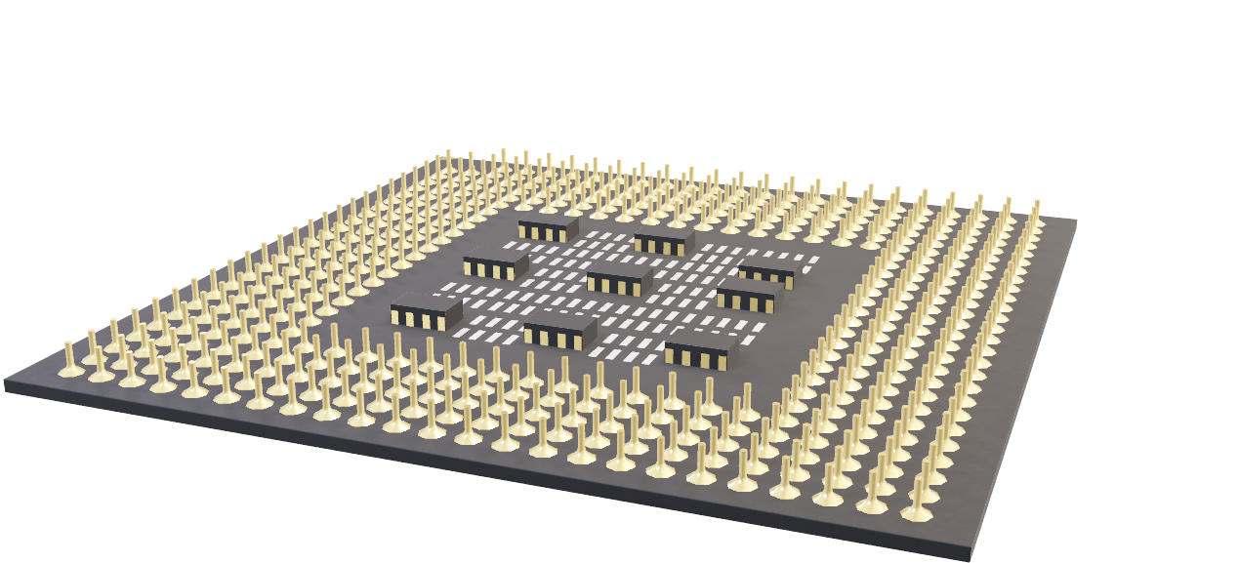
What is RFID Technology?

Slide 5

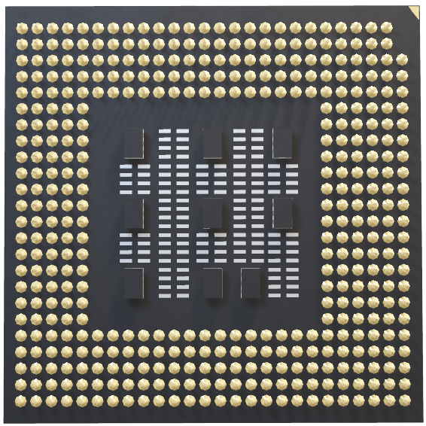
What is RFID Technology?
Radio Frequency Identification (RFID) uses electromagnetic fields to identify and track tags attached to objects automatically. These tags contain electronically stored information that can be read by RFID readers.
Automated Attendance Tracking: Reduces human error and manual labor.
Enhanced Security: Provides a secure method for tracking attendance and payments.
Increased Efficiency: Streamlines administrative processes, allowing staff to focus on other important tasks.
Data Accuracy: Minimizes errors and improves the reliability of student data.
Advantages in Educational Institutions:

Slide 6

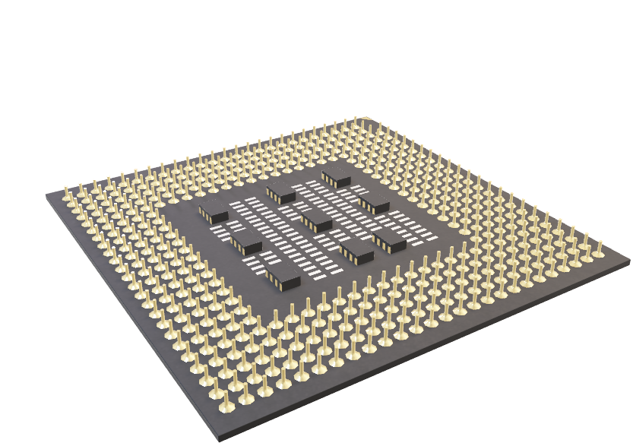
Project Motivation
Educational institutions are increasingly adopting automated systems to enhance operational efficiency, data accuracy, and student experience. In large university environments, traditional attendance tracking, and cash-based payment systems are not only time-consuming but also prone to errors, security risks, and scalability issues.

Slide 7
Problem Statement
Limited Parental Oversight
High Administrative Costs
Lack of Financial Guidance
Cash-Based Transactions
Manual Attendance Tracking
Inadequate Data for Service Optimization
Parents lack real-time access to attendance and spending.
Manual processes increase operational expenses.
Students lack budgeting and spending guidance.
Security risks and limited data insights.
Prone to errors and lacks real-time updates
Limited insights into student preferences.

Slide 8
Related Work
Case Study: Improved Attendance Using RFID (Samaddar et al., 2023)
Based on Samaddar et al. (2023), the RFID system demonstrated a 128.57% improvement across accuracy, efficiency, and engagement metrics compared to manual methods.

Slide 9
Case Study: RFID-Driven Cashless Efficiency on Campus (Shinde, 2024)
Case Study: Improved Attendance Using RFID (Samaddar et al., 2023)
Based on Samaddar et al. (2023), the RFID system demonstrated a 128.57% improvement across accuracy, efficiency, and engagement metrics compared to manual methods.
According to Shinde (2024), RFID integration improved transaction speed by 38% and reduced financial errors by approximately 29%.

Slide 10
Case Study: RFID-Driven Cashless Efficiency on Campus (Shinde, 2024)
According to Shinde (2024), RFID integration improved transaction speed by 38% and reduced financial errors by approximately 29%.

Slide 11


Project bjectives
Case Study: Improved Attendance Using RFID (Samaddar et al., 2023)
Parental Oversight
Provide Personalized Budget Management
Enable Financial Oversight and Analysis
Parents will be able to real-time access to attendance and spending data.
Offer tools that help students manage their funds, receive budget advice, and track spending tailored to their individual needs.
Provide administrators and parents with categorized insights into student expenses, aiding in better financial decision-making and tracking.
Implement a Scalable Attendance Tracking System Using RFID
Facilitate Secure, Cashless Transactions
Ensure Data Integrity and Security
Design an RFID-based system that accurately tracks attendance and can be expanded to accommodate more students and courses as needed.
Enable cashless payments within campus premises, ensuring safety and reducing cash-handling risks.
Maintain accurate, real-time logs of student attendance and transactions while protecting sensitive data from unauthorized access or breaches.

Slide 12
Project Objectives
Parental Oversight
Provide Personalized Budget Management
Enable Financial Oversight and Analysis
Implement a Scalable Attendance Tracking System Using RFID
Facilitate Secure, Cashless Transactions
Ensure Data Integrity and Security
Parents will be able to real-time access to attendance and spending data.
Offer tools that help students manage their funds, receive budget advice, and track spending tailored to their individual needs.
Provide administrators and parents with categorized insights into student expenses, aiding in better financial decision-making and tracking.
Design an RFID-based system that accurately tracks attendance and can be expanded to accommodate more students and courses as needed.
Enable cashless payments within campus premises, ensuring safety and reducing cash-handling risks.
Maintain accurate, real-time logs of student attendance and transactions while protecting sensitive data from unauthorized access or breaches.

Slide 13
Proposed Solution
Unified Payment System
Data Analytics Feature
Parental Access Feature
Offer tools that help students manage their funds, receive budget advice, and track spending tailored to their individual needs.
Parents will be able to real-time access to attendance and spending data.
The system collects and analyzes transaction data, providing insights into user behavior and operational efficiency.

Slide 14
Proposed Solution
Implement a Scalable System
Web Application Integration
Personal Finance Management Tool
Design an RFID-based system that can be expanded to accommodate more features as needed.
Users can monitor their transactions and balances in real-time via a web application, allowing for better financial management.
The web application provides personalized financial tips and tracking tools, helping students manage their budgets effectively

Slide 15


Dataset
Attendance Dataset
Literature Review 1/4
500k+ records
Features: Sign-in/out, lecture times, status
Computed: delay, minutes attended
Challenges: missing data, class imbalance
Ishaq & Bibi (2023): “IoT-Based Smart Attendance System Using RFID”
Samaddar et al. (2023): “IoT & Cloud-Based Smart Attendance Management System Using RFID”
Impact: Improves efficiency, reliability, and scalability, highlighting RFID’s potential in campus settings.
Focus: Uses cloud storage for scalable and accessible attendance data.
Impact: Demonstrates the benefits of RFID in large institutions, emphasizing security and real-time data access.

Slide 16

Dataset (1/2)
500k+ records
Features: Sign-in/out, lecture times, status, amount spent
Computed: delay, minutes attended, spending patterns
Challenges: missing data, class imbalance

Slide 17


Dataset (2/2)
 | Student ID | Date | Day | Course Code | Course Name | Time Lecture Started | Time Lecture Ended | Lecture Duration | Student Sign-in to Lecture | Student Sign-out from Lecture | Status
1 | S001325 | 12/31/2024 | Tuesday | CHEM505 | Physics Fundamentals | 8:10 | 9:19 | 69 | 8:16 | 9:09 | late
2 | S004829 | 12/31/2024 | Tuesday | CHEM505 | Physics Fundamentals | 9:50 | 10:52 | 62 |  |  | absent
3 | S003046 | 12/31/2024 | Tuesday | CS202 | Data Structures | 8:06 | 9:28 | 82 | 8:08 | 9:32 | present
4 | S001865 | 12/31/2024 | Tuesday | PHY303 | Advanced Mathematics | 9:35 | 10:58 | 83 | 9:42 | 10:53 | late
5 | S009011 | 12/31/2024 | Tuesday | CS202 | Physics Fundamentals | 8:27 | 9:35 | 68 |  |  | absent
6 | S009011 | 12/31/2024 | Tuesday | CS202 | Advanced Mathematics | 9:40 | 11:07 | 87 | 9:53 | 10:58 | late
7 | S004347 | 12/31/2024 | Tuesday | PHY303 | Physics Fundamentals | 15:46 | 16:50 | 64 | 16:02 | 16:42 | late
8 | S004435 | 12/31/2024 | Tuesday | PHY303 | Advanced Mathematics | 15:48 | 16:54 | 66 |  |  | absent
9 | S004829 | 12/31/2024 | Tuesday | CHEM505 | Data Structures | 12:47 | 13:57 | 70 | 12:55 | 13:51 | late
10 | S005835 | 12/31/2024 | Tuesday | CHEM505 | Intro to Biology | 9:31 | 10:52 | 81 | 9:33 | 10:56 | present
11 | S003828 | 12/31/2024 | Tuesday | PHY303 | Intro to Biology | 8:16 | 9:18 | 62 |  |  | absent
11 | S001325 | 12/31/2024 | Tuesday | CS202 | Advanced Mathematics | 8:04 | 9:20 | 76 | 8:04 | 9:21 | present
12 | S004829 | 12/31/2024 | Tuesday | CHEM505 | Physics Fundamentals | 8:10 | 9:19 | 69 | 8:16 | 9:09 | late
Target variable: Status (present, absent, late) & Spending Category
Preprocessing: Time formatting, normalization, categorical encoding
Feature Engineering: Delay, duration, student history, daily spending Models Used:
• ANN for Attendance Prediction (98% Accuracy)
• Linear Regression for Spending Forecast (96% Accuracy)
• Decision Tree for Behavior Categorization

Slide 18


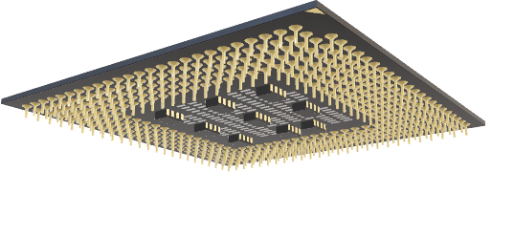
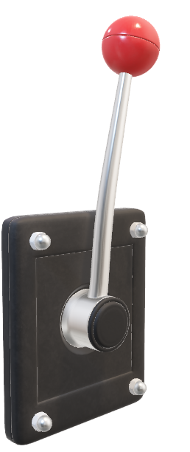
Algorithm Overview
 | Student ID | Date | Day | Course Code | Course Name | Time Lecture Started | Time Lecture Ended | Lecture Duration | Student Sign-in to Lecture | Student Sign-out from Lecture | Status
1 | S001325 | 12/31/2024 | Tuesday | CHEM505 | Physics Fundamentals | 8:10 | 9:19 | 69 | 8:16 | 9:09 | late
2 | S004829 | 12/31/2024 | Tuesday | CHEM505 | Physics Fundamentals | 9:50 | 10:52 | 62 |  |  | absent
3 | S003046 | 12/31/2024 | Tuesday | CS202 | Data Structures | 8:06 | 9:28 | 82 | 8:08 | 9:32 | present
4 | S001865 | 12/31/2024 | Tuesday | PHY303 | Advanced Mathematics | 9:35 | 10:58 | 83 | 9:42 | 10:53 | late
5 | S009011 | 12/31/2024 | Tuesday | CS202 | Physics Fundamentals | 8:27 | 9:35 | 68 |  |  | absent
6 | S009011 | 12/31/2024 | Tuesday | CS202 | Advanced Mathematics | 9:40 | 11:07 | 87 | 9:53 | 10:58 | late
7 | S004347 | 12/31/2024 | Tuesday | PHY303 | Physics Fundamentals | 15:46 | 16:50 | 64 | 16:02 | 16:42 | late
8 | S004435 | 12/31/2024 | Tuesday | PHY303 | Advanced Mathematics | 15:48 | 16:54 | 66 |  |  | absent
9 | S004829 | 12/31/2024 | Tuesday | CHEM505 | Data Structures | 12:47 | 13:57 | 70 | 12:55 | 13:51 | late
10 | S005835 | 12/31/2024 | Tuesday | CHEM505 | Intro to Biology | 9:31 | 10:52 | 81 | 9:33 | 10:56 | present
11 | S003828 | 12/31/2024 | Tuesday | PHY303 | Intro to Biology | 8:16 | 9:18 | 62 |  |  | absent
11 | S001325 | 12/31/2024 | Tuesday | CS202 | Advanced Mathematics | 8:04 | 9:20 | 76 | 8:04 | 9:21 | present
12 | S004829 | 12/31/2024 | Tuesday | CHEM505 | Physics Fundamentals | 8:10 | 9:19 | 69 | 8:16 | 9:09 | late
Preprocessing Steps:
Missing values in time columns replaced with '00:00'.
Categorical encoding for 'Status' using LabelEncoder.
Feature scaling using StandardScaler.
Models Used:
Artificial Neural Network (ANN):
Trained to predict attendance status with dropout layers to mitigate overfitting.
Decision Tree:
Used with hyperparameter tuning to identify best configurations.
Key Metrics:
ANN Accuracy: ~85.54%.
Decision Tree : ~81.31%.
System Implementation

Slide 19


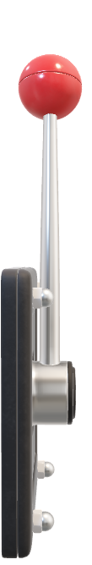
Methodology
Literature Review 1/4
 | Student ID | Date | Day | Course Code | Course Name | Time Lecture Started | Time Lecture Ended | Lecture Duration | Student Sign-in to Lecture | Student Sign-out from Lecture | Status
1 | S001325 | 12/31/2024 | Tuesday | CHEM505 | Physics Fundamentals | 8:10 | 9:19 | 69 | 8:16 | 9:09 | late
2 | S004829 | 12/31/2024 | Tuesday | CHEM505 | Physics Fundamentals | 9:50 | 10:52 | 62 |  |  | absent
3 | S003046 | 12/31/2024 | Tuesday | CS202 | Data Structures | 8:06 | 9:28 | 82 | 8:08 | 9:32 | present
4 | S001865 | 12/31/2024 | Tuesday | PHY303 | Advanced Mathematics | 9:35 | 10:58 | 83 | 9:42 | 10:53 | late
5 | S009011 | 12/31/2024 | Tuesday | CS202 | Physics Fundamentals | 8:27 | 9:35 | 68 |  |  | absent
6 | S009011 | 12/31/2024 | Tuesday | CS202 | Advanced Mathematics | 9:40 | 11:07 | 87 | 9:53 | 10:58 | late
7 | S004347 | 12/31/2024 | Tuesday | PHY303 | Physics Fundamentals | 15:46 | 16:50 | 64 | 16:02 | 16:42 | late
8 | S004435 | 12/31/2024 | Tuesday | PHY303 | Advanced Mathematics | 15:48 | 16:54 | 66 |  |  | absent
9 | S004829 | 12/31/2024 | Tuesday | CHEM505 | Data Structures | 12:47 | 13:57 | 70 | 12:55 | 13:51 | late
10 | S005835 | 12/31/2024 | Tuesday | CHEM505 | Intro to Biology | 9:31 | 10:52 | 81 | 9:33 | 10:56 | present
11 | S003828 | 12/31/2024 | Tuesday | PHY303 | Intro to Biology | 8:16 | 9:18 | 62 |  |  | absent
11 | S001325 | 12/31/2024 | Tuesday | CS202 | Advanced Mathematics | 8:04 | 9:20 | 76 | 8:04 | 9:21 | present
12 | S004829 | 12/31/2024 | Tuesday | CHEM505 | Physics Fundamentals | 8:10 | 9:19 | 69 | 8:16 | 9:09 | late
Ishaq & Bibi (2023): “IoT-Based Smart Attendance System Using RFID”
Samaddar et al. (2023): “IoT & Cloud-Based Smart Attendance Management System Using RFID”
Impact: Improves efficiency, reliability, and scalability, highlighting RFID’s potential in campus settings.
Focus: Uses cloud storage for scalable and accessible attendance data.
Impact: Demonstrates the benefits of RFID in large institutions, emphasizing security and real-time data access.

Slide 20
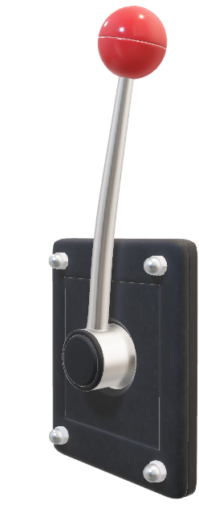
Methodology
Drop missing/invalid entries
Filter lecture durations (0–180 mins)
Normalize status (present → 1, else 0)
Label encode Day & Course Feature Engineering:
was_present_last_time
rolling_absences (7 lectures)
time_of_day bucket
SMOTE for class balancing
Train/Test Split: 80/20

Slide 21
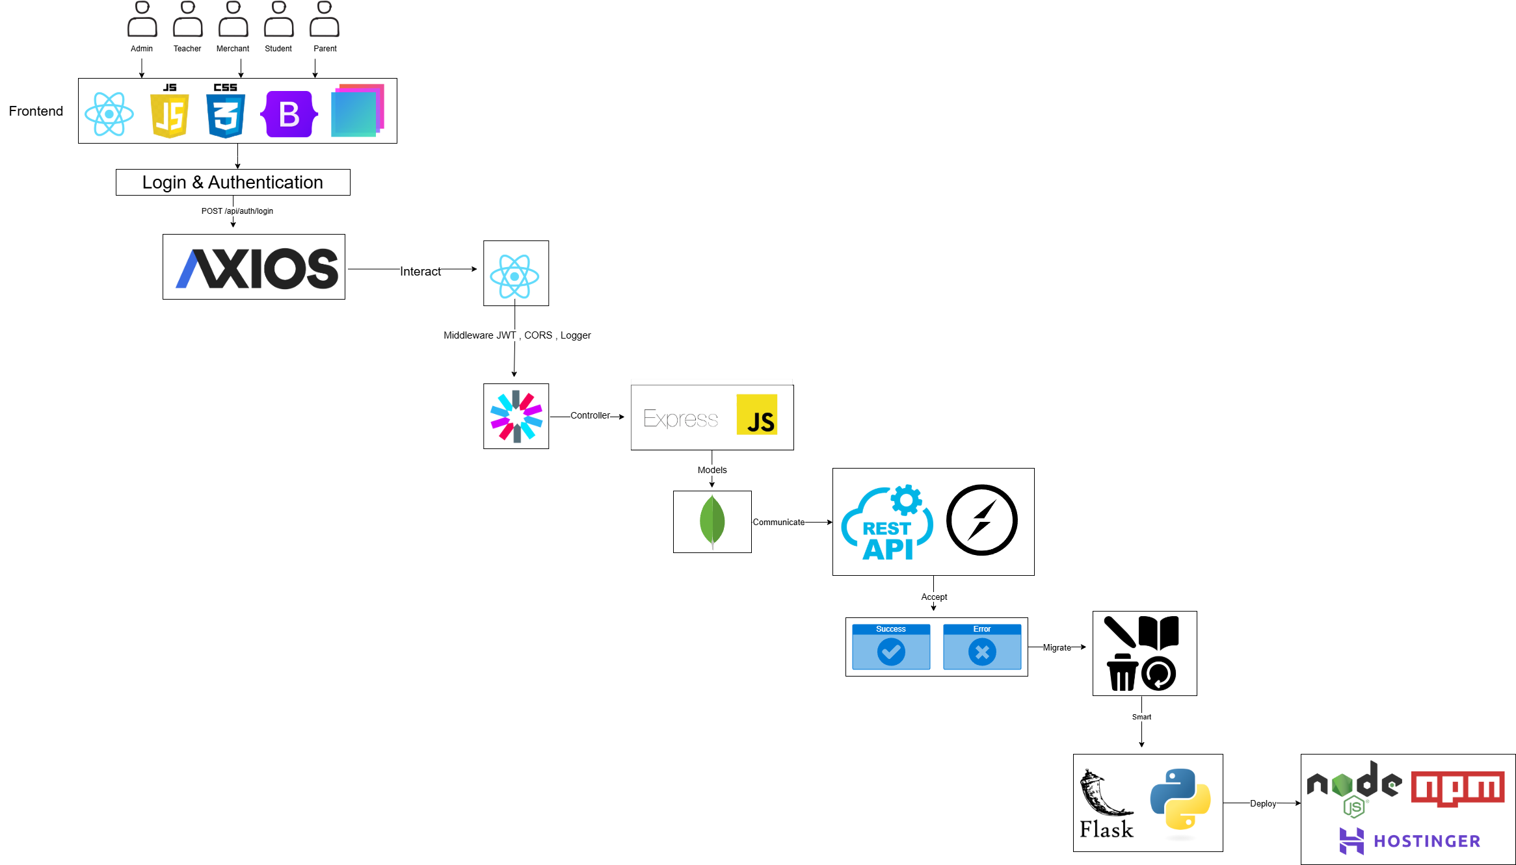
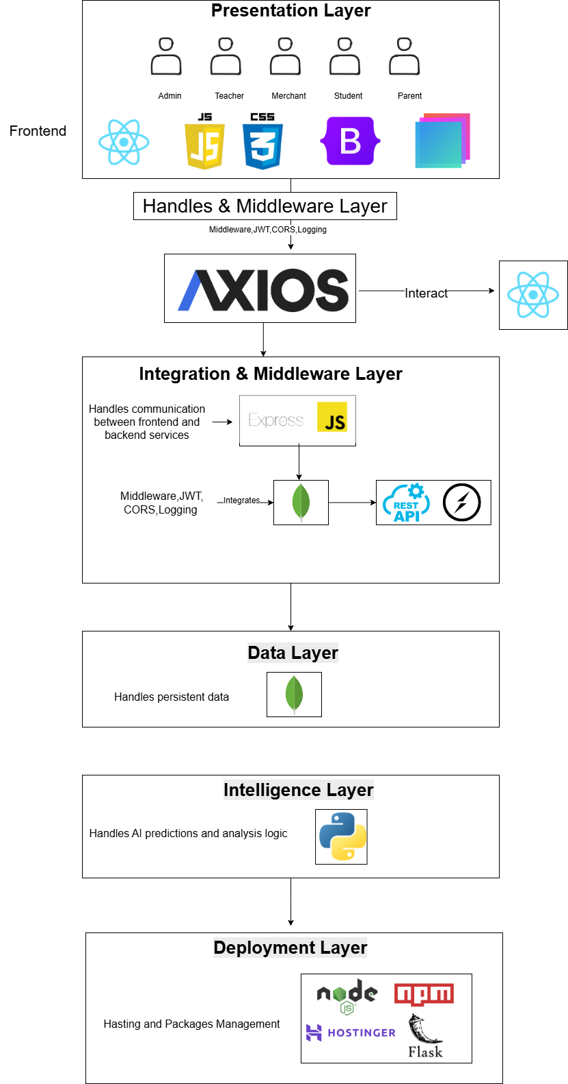

System Architecture
Literature Review 1/4
Ishaq & Bibi (2023): “IoT-Based Smart Attendance System Using RFID”
Samaddar et al. (2023): “IoT & Cloud-Based Smart Attendance Management System Using RFID”
Impact: Improves efficiency, reliability, and scalability, highlighting RFID’s potential in campus settings.
Focus: Uses cloud storage for scalable and accessible attendance data.
Impact: Demonstrates the benefits of RFID in large institutions, emphasizing security and real-time data access.

Slide 22
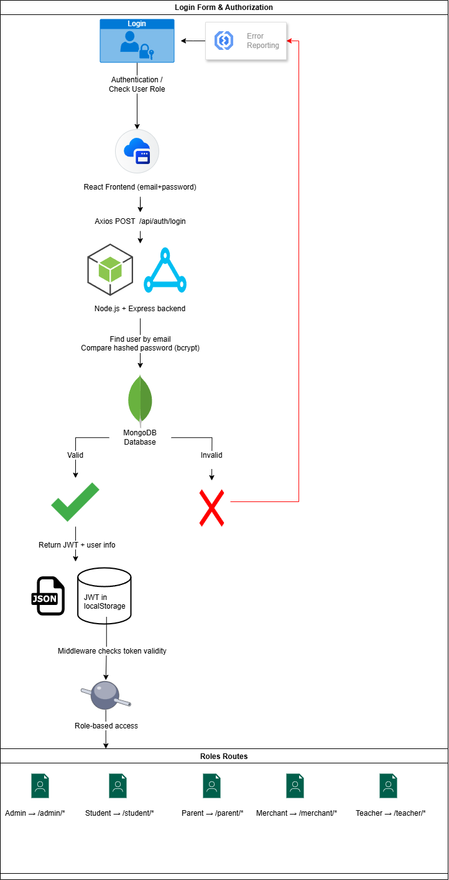



Slide 23
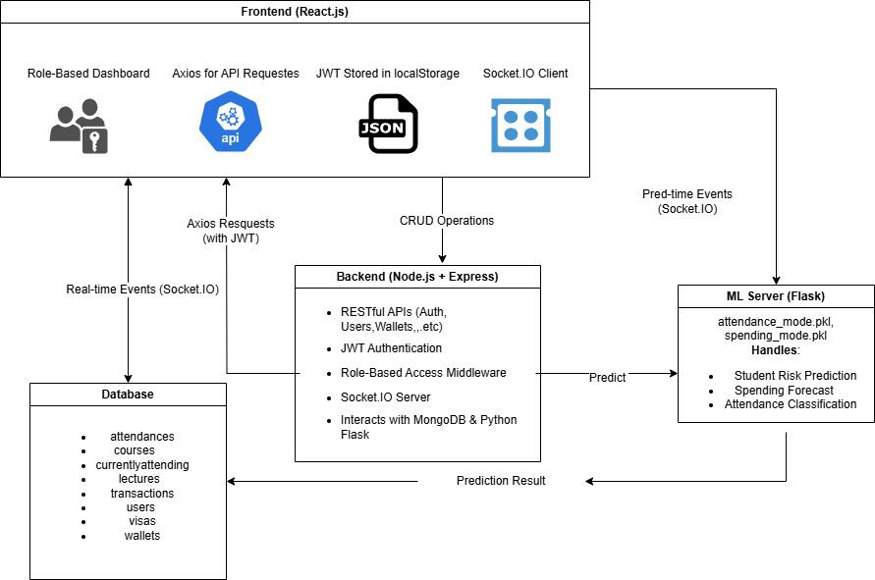

Slide 24
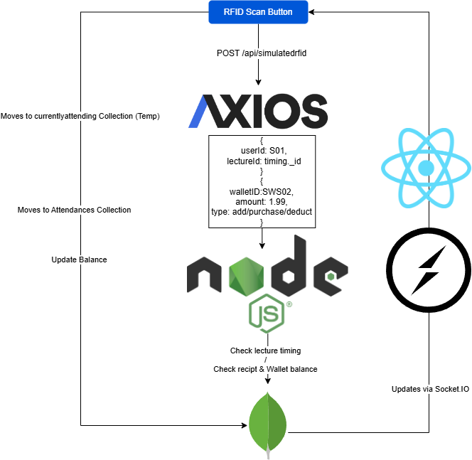

Slide 26


Model: XGBoost (tuned via GridSearch)
Accuracy: ~85%
Balanced performance on imbalanced data
Confusion matrix and classification report support result
Results
Results
Metric | Manual | RFID
Attendance Accuracy | ~ 45% - ~65% | 98%
Transaction Errors | Frequent | Reduced by ~29%
Parental Insights | None | Real-time dashboard
Admin Time | High | Reduced ~40%
Cost of Operations | High (paper, staff) | Lower (one-time setup)
Data Availability | Delayed/manual | Instant & automatic
Analysis Time | Long | Real-time reports
Scalability | Limited | High (supports growth)

Slide 27



Results
Metric | Manual | RFID
Attendance Accuracy | ~ 45% - ~65% | 98%
Transaction Errors | Frequent | Reduced by ~29%
Parental Insights | None | Real-time dashboard
Admin Time | High | Reduced ~40%
Cost of Operations | High (paper, staff) | Lower (one-time setup)
Data Availability | Delayed/manual | Instant & automatic
Analysis Time | Long | Real-time reports
Scalability | Limited | High (supports growth)

Slide 28
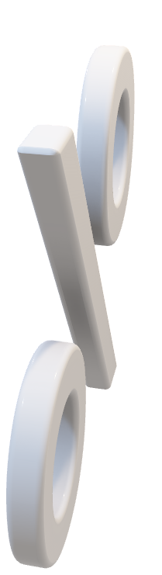

Project Demo
Results
Literature Review 1/4
Metric | Manual | RFID
Attendance Accuracy | ~ 45% - ~65% | 98%
Transaction Errors | Frequent | Reduced by ~29%
Parental Insights | None | Real-time dashboard
Admin Time | High | Reduced ~40%
Cost of Operations | High (paper, staff) | Lower (one-time setup)
Data Availability | Delayed/manual | Instant & automatic
Analysis Time | Long | Real-time reports
Scalability | Limited | High (supports growth)
Ishaq & Bibi (2023): “IoT-Based Smart Attendance System Using RFID”
Samaddar et al. (2023): “IoT & Cloud-Based Smart Attendance Management System Using RFID”
Impact: Improves efficiency, reliability, and scalability, highlighting RFID’s potential in campus settings.
Focus: Uses cloud storage for scalable and accessible attendance data.
Impact: Demonstrates the benefits of RFID in large institutions, emphasizing security and real-time data access.

Slide 29

Dataset

Slide 30

System Implementation
System Implementation
Literature Review 1/4
Ishaq & Bibi (2023): “IoT-Based Smart Attendance System Using RFID”
Samaddar et al. (2023): “IoT & Cloud-Based Smart Attendance Management System Using RFID”
Impact: Improves efficiency, reliability, and scalability, highlighting RFID’s potential in campus settings.
Focus: Uses cloud storage for scalable and accessible attendance data.
Impact: Demonstrates the benefits of RFID in large institutions, emphasizing security and real-time data access.
Frontend: React.js (Role-based dashboards)
Backend: Node.js + Express (REST & WebSocket APIs)
Database: MongoDB
ML Models: ANN & Random Forest
Functions: Real-time stats, attendance prediction, spending forecast

Slide 31
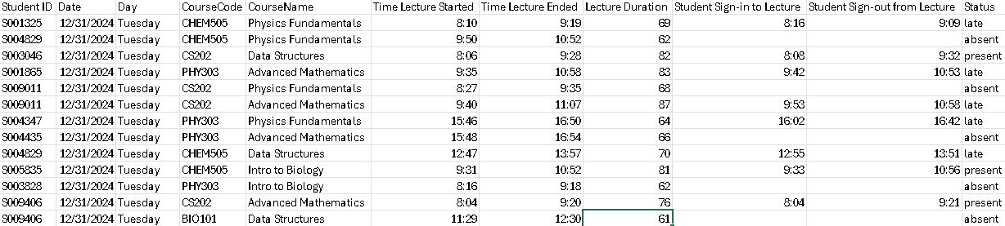
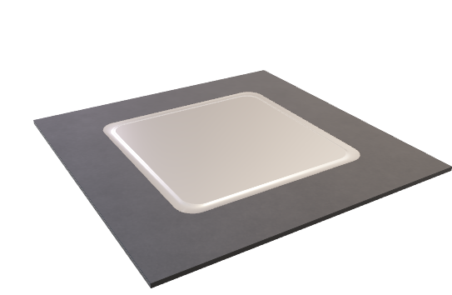

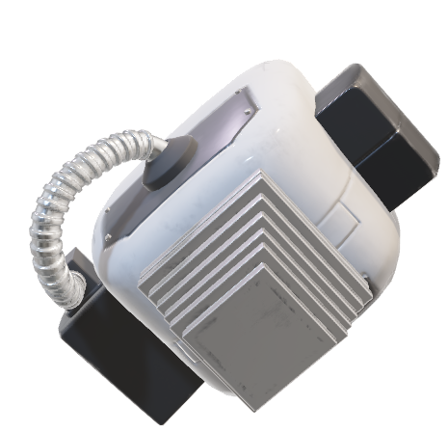
System Implementation
Frontend: React.js (Role-based dashboards)
Backend: Node.js + Express (REST APIs & authentication)
Database: MongoDB (Flexible NoSQL document store)
Real-time Updates: Socket.IO (Live RFID scan + dashboard sync)
Machine Learning Models:
- DecisionTreeClassifier
- Classifies attendance behavior (Excellent, Moderate, Poor)
- Categorizes spending patterns and types
- LinearRegression
- Predicts next week's average spending
- Forecasts upcoming attendance rate
- Planned Extensions:
- LogisticRegression or RandomForestClassifier
- Predict course-specific attendance reliability
- Rule-based feedback engine
Budget advice & attendance coaching
- Models are trained in Python (Flask ML microservice) and connected via API.

Slide 32

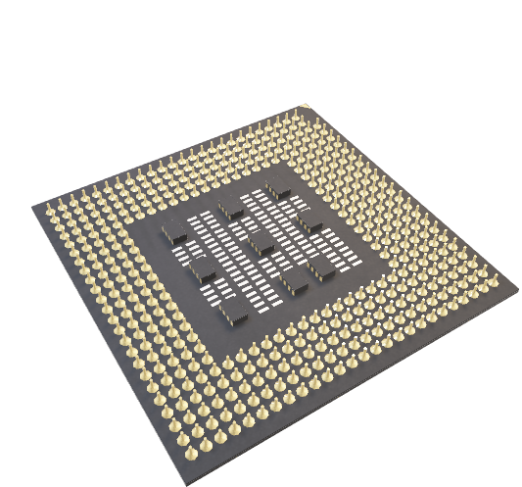
Key Features
Role-based dashboards (Admin, Student, Parent, Teacher, Merchant)
Real-time RFID simulation
Wallet funding and transaction history
Attendance tracking with predictive analytics

Slide 33
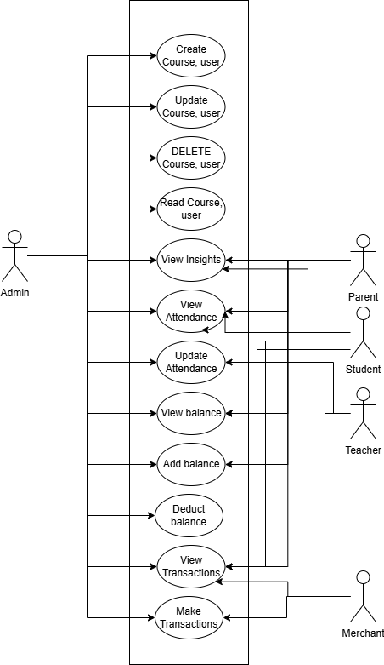


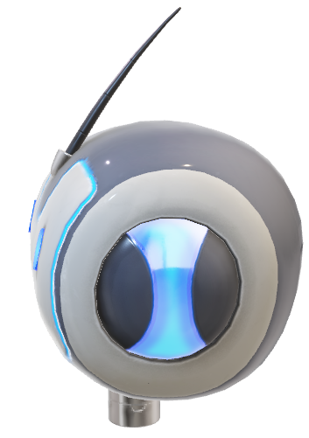

Use Case Diagram

Slide 34

Class Diagram
Parent
Admin
Student
Teacher
Merchant

Slide 35
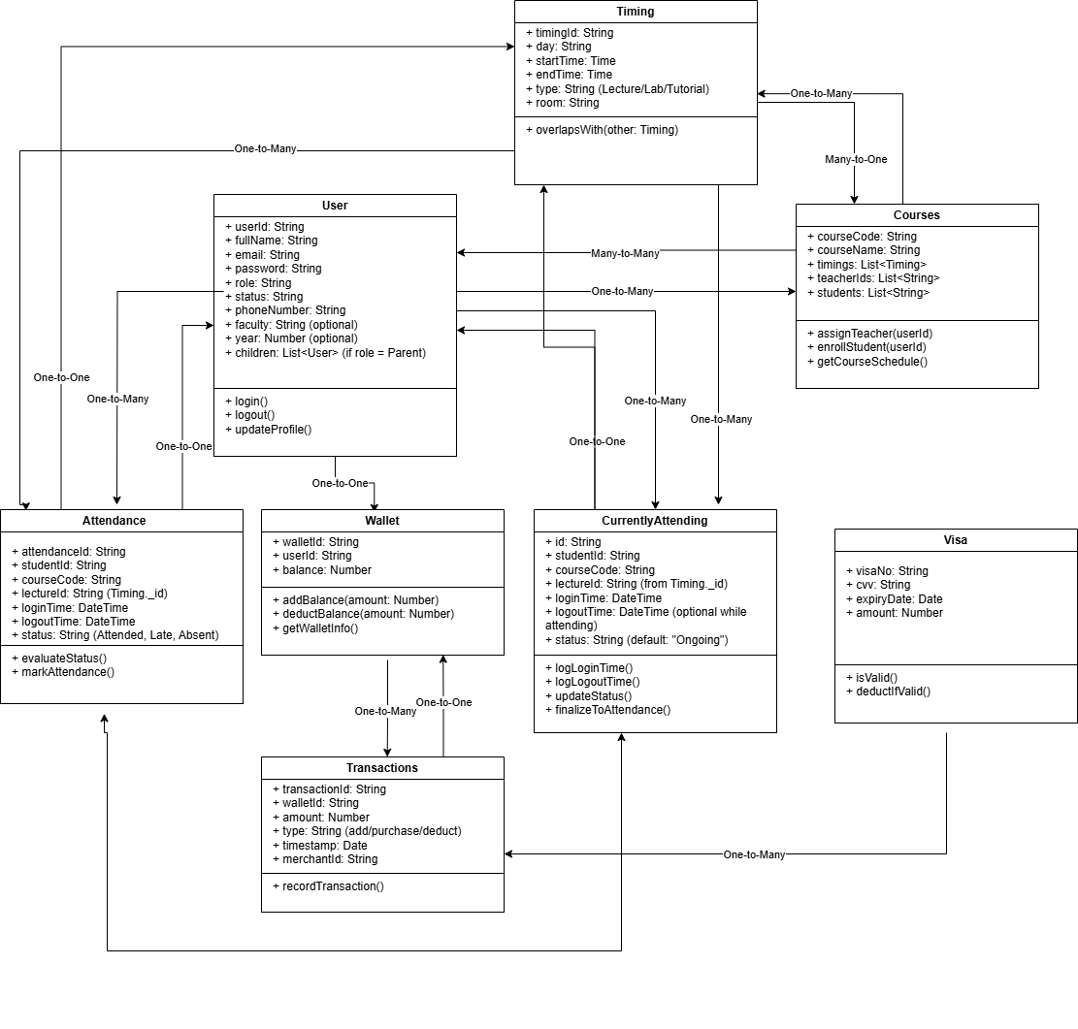
Class Diagram
Literature Review 1/4
Ishaq & Bibi (2023): “IoT-Based Smart Attendance System Using RFID”
Samaddar et al. (2023): “IoT & Cloud-Based Smart Attendance Management System Using RFID”
Impact: Improves efficiency, reliability, and scalability, highlighting RFID’s potential in campus settings.
Focus: Uses cloud storage for scalable and accessible attendance data.
Impact: Demonstrates the benefits of RFID in large institutions, emphasizing security and real-time data access.

Slide 36
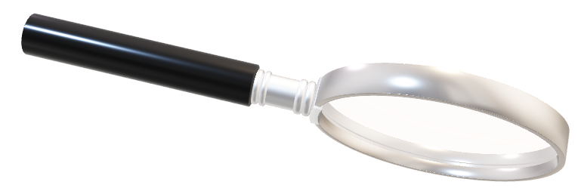

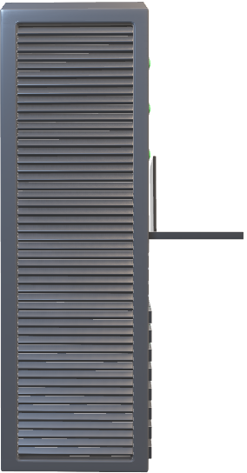

Slide 37



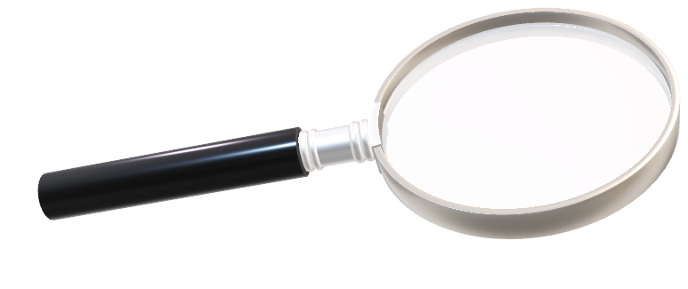

Testing & Evaluation
UAT | Metric | Value
1 | Total Respondents | 21
2 | Majority Age Group | 18-24
3 | Most Common Role | Student
4 | Average Familiarity with Admin Systems (1–5) | 2.9
5 | Average Ease of Understanding Dashboard (1–5) | 4.0
6 | Layout Satisfaction (%) | 81%
7 | Chart Clarity (%) | 85.7%
8 | Homepage Clarity (%) | 90.5%
9 | Homepage Professional Look (%) | 95.2%
10 | Recommendation Rate | 90.5%
Functional: Login, RFID, Wallet, CRUD – all passed
Performance: 420ms API, 150ms socket, <300ms DB
UAT: Positive feedback from users
Scalability: Stable under 50+ scans/min
Testing & Evaluation (Usability)
Use Case Diagram

Slide 38

UAT | Metric | Value
1 | Total Respondents | 21
2 | Majority Age Group | 18-24
3 | Most Common Role | Student
4 | Average Familiarity with Admin Systems (1–5) | 2.9
5 | Average Ease of Understanding Dashboard (1–5) | 4.0
6 | Layout Satisfaction (%) | 81%
7 | Chart Clarity (%) | 85.7%
8 | Homepage Clarity (%) | 90.5%
9 | Homepage Professional Look (%) | 95.2%
10 | Recommendation Rate | 90.5%
Testing & Evaluation (Usability)
Use Case Diagram

Slide 39



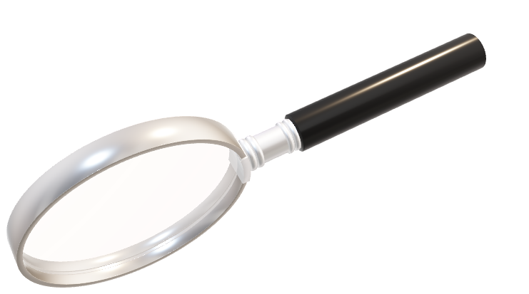
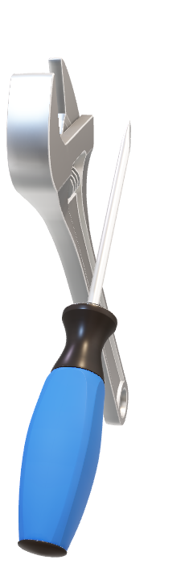
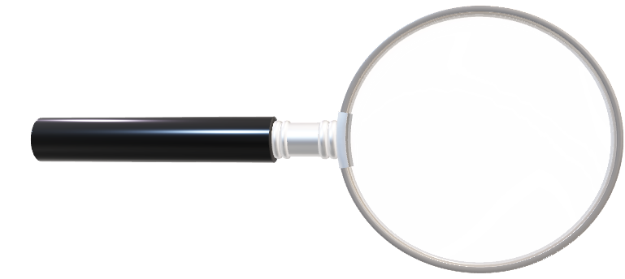
Future Work
Mobile App
Facial Recognition for attendance
Advanced ML for anomaly detection
Campus-wide real deployment
International Academy of Advanced Research (IAAR)
Use Case Diagram

Slide 40
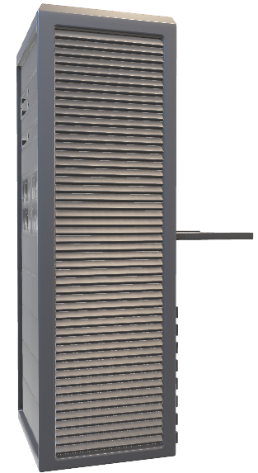



International Academy of Advanced Research (IAAR)

Slide 41



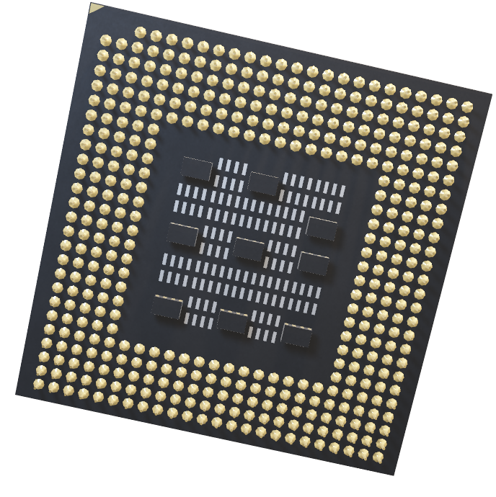
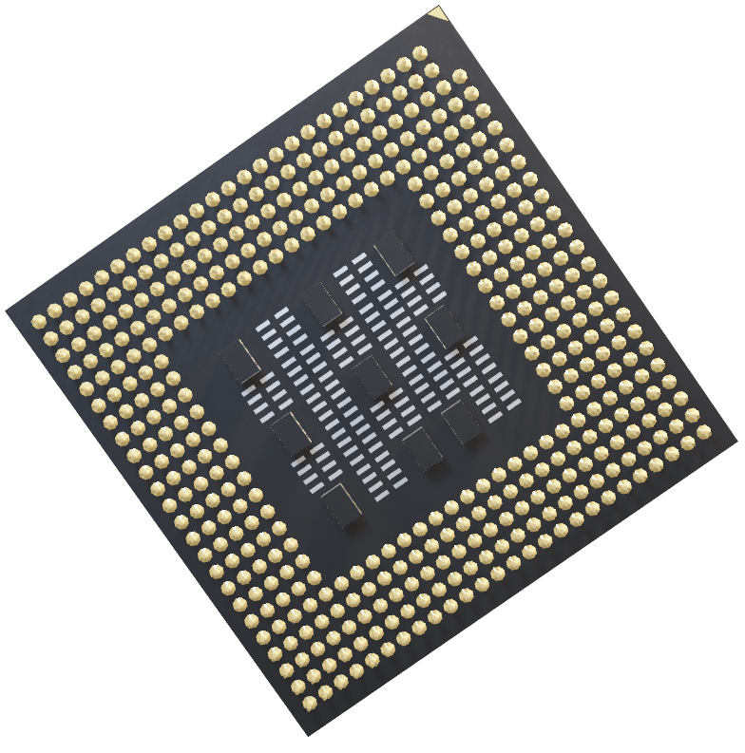
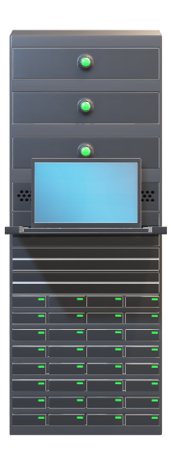

Conclusion
Q&A
Scalable and Secure Solution
Enhanced Transaction Speed
Improved Financial Accuracy
Real-Time Parental Access
Comprehensive Data Insights
Increased User Convenience
Streamlined Campus Operations
Future Expansion Opportunities
Alignment with Smart Campus Initiatives

Slide 42

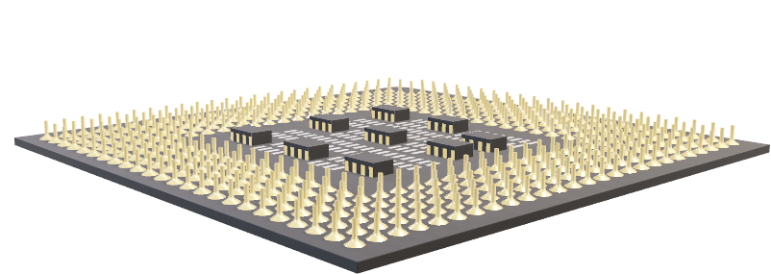

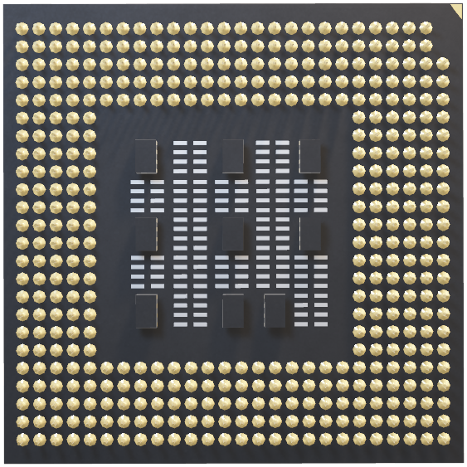

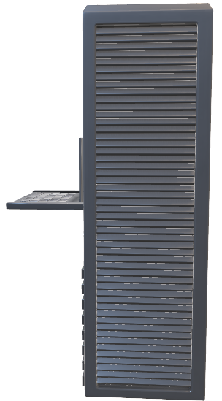
Q&A

Slide 43
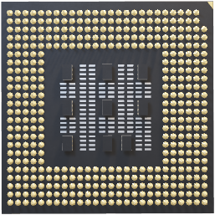


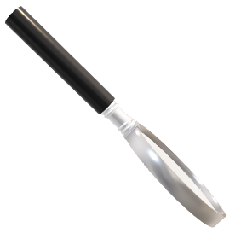
REFRENCES
Ishaq, K., & Bibi, S. (2023). IoT based smart attendance system using RFID: A systematic literature review. arXiv preprint arXiv:2308.02591. https://arxiv.org/abs/2308.02591v1
Samaddar, R., Rajarshi, A., Kumar, A., & Singh, S. (2023). IoT & cloud-based smart attendance management system using RFID. International Research Journal on Advanced Science Hub (IRJASH), 5(3), 111–118. https://rspsciencehub.com/index.php/journal/article/view/633
Shinde, S. (2024). Case study on RFID-based cashless systems in university campuses and their implementation challenges. International Journal of Ingenious Research, Invention and Development, 3(2), 122–123. https://doi.org/10.5281/zenodo.11066231
Yadav, S., & Dalvi, S. (2023). RFID, GSM, and IoT-based secure college ID for attendance, payment, and door access. International Journal of Emerging Trends in Engineering and Applied Sciences, 13(5), 202–206.

Slide 44



Thank you
Hossam Mohamed
213885
Faculty Of Computer Science
Software Engineering

